Slide 1
Installation of Manufactured homes in proximity of Transmission Line Rights of Way

Slide 2
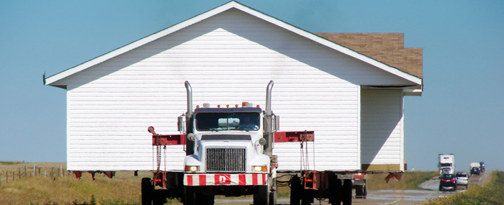
The intent of this training is to partner with the AMHC and manufactured housing professionals.

Slide 3
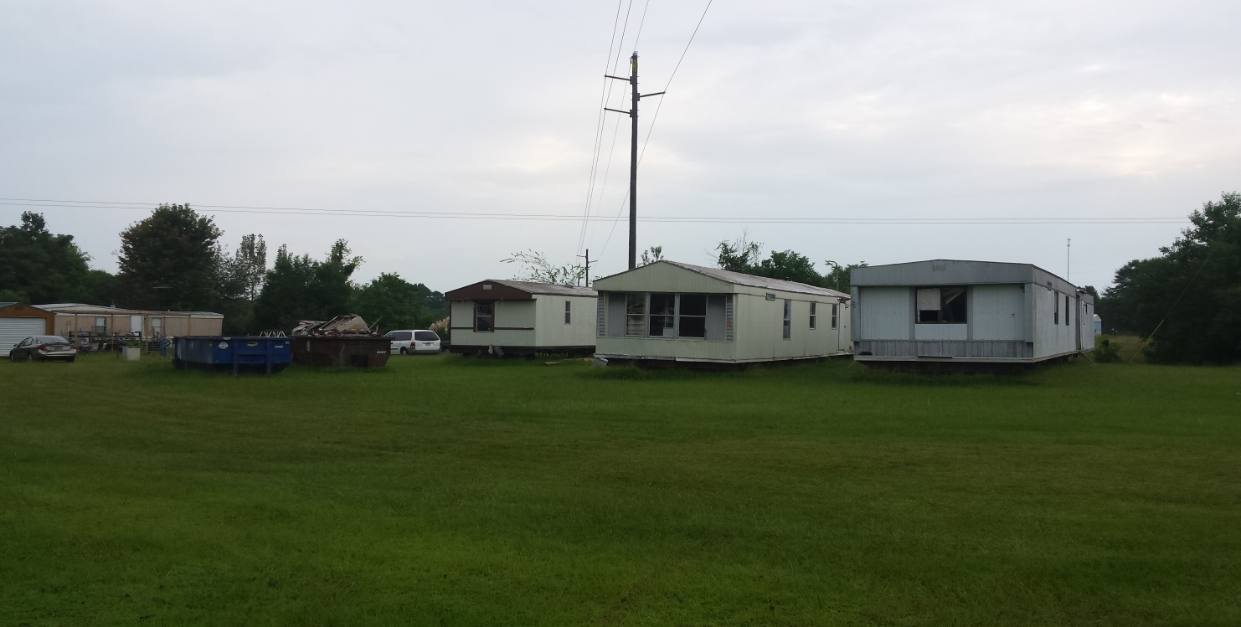
Southern Company nor any of its OPCo’s (Alabama Power, Georgia Power, Gulf Power, & Mississippi Power) allow permanent structures, (including manufactured homes) on its Rights of Way (even for temporary storage)

Slide 4
Manufactured Homes being placed on ANY Transmission Line Rights of Way could put both your customers, our customers, your employees, and our employees, in a HAZARDOUS situation.
We need your help in preventing these situations!!!

Slide 5
Alabama Power Company Transmission Line Rights of Way are anything but a “typical width.” And that line can be situated anywhere within the right of way
Transmission Line H-Frame Structure
50'
25'
25'
100'

Slide 6
More Transmission Line Rights of Way and Line situation examples
Single Pole Structure
H-Frame Structure
Single Pole Structure
50'
12.5'
12.5'
30'
25'
50'
180'
H-Frame Structure
uncleared
50'
25'
25'
100'

Slide 7
In many cases, Alabama Power is not clearing the full extents of its Transmission Line Rights of Way!
BE CAREFUL HERE!

Slide 8
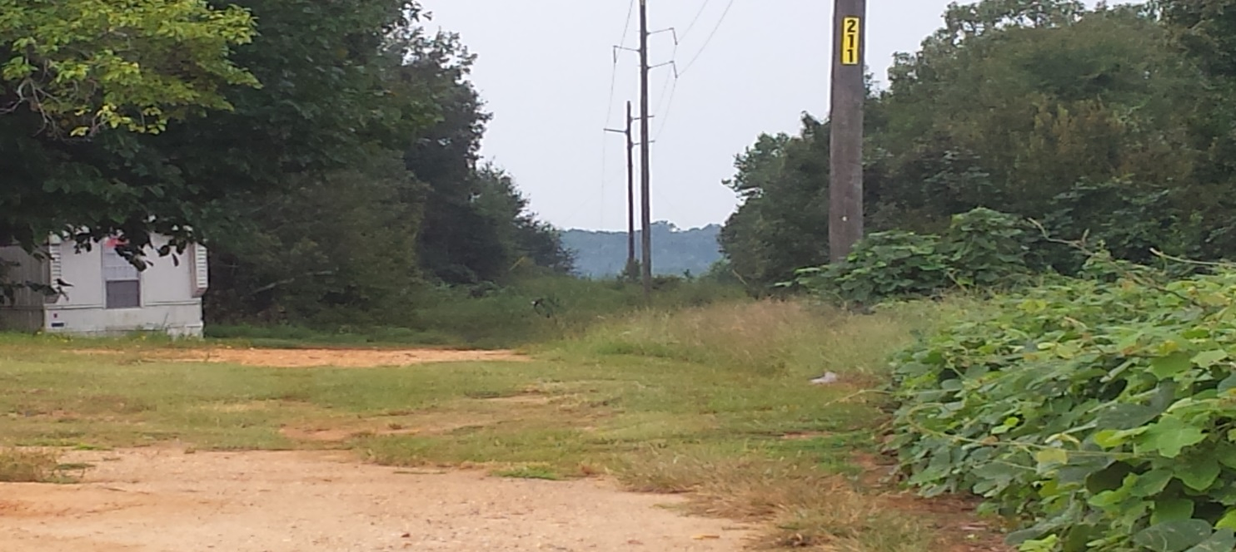
Here is an example of 100’ wide Transmission Line Rights of Way, where the full extents are not being cleared.
Single Pole Structure
uncleared
uncleared
25'
25'
25'
25'
100'

Slide 9
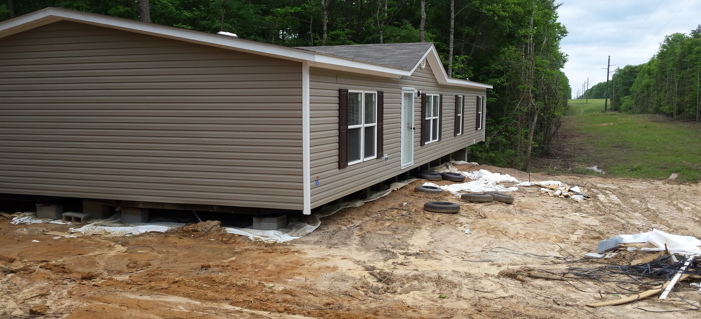
Here is a brand new home placed in Alabama Power Transmission Line Rights of Way!
Single Pole Structure
uncleared
uncleared
25'
25'
25'
25'
100'

Slide 10
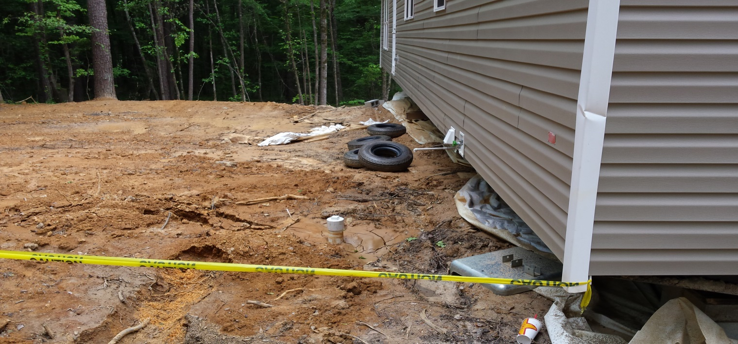
Septic also installed on the Transmission Line Rights of Way which is also a discouraged encroachment.
Single Pole Structure
uncleared
uncleared
25'
25'
25'
25'
100'

Slide 11
We talk a lot about safety and hazards, but there is USUALLY a significant investment IN these scenarios!
Lot Clearing $$$$$$$$
Septic Tank installation $$$$$$$
Driveway Expense $$$$$$
Brand new manufactured home $$$$$$$$
Moving and installing manufactured home $$$$$$$
All other moving expenses $$$$$$$
Other Utilities $$$$$$$
As professionals, we owe it to our communities and neighbors to do the right thing!

Slide 12
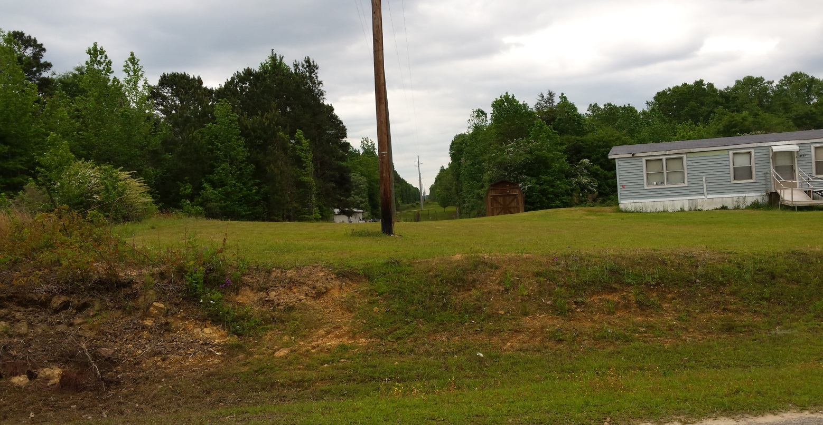
Remember the brand new manufactured home from above, here are their neighbors in the same scenario!
Single Pole Structure
uncleared
uncleared
25'
25'
25'
25'
100'

Slide 13
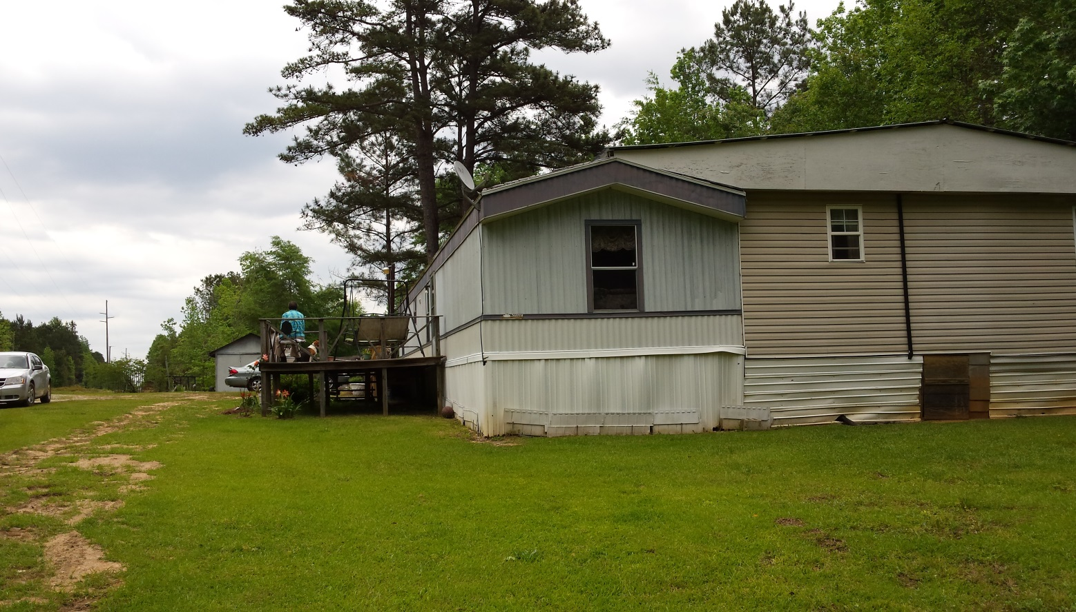
More neighbors!!!!!
Single Pole Structure
uncleared
uncleared
25'
25'
25'
25'
100'

Slide 14
We need your help!
IF the landowner is wanting to place their home on the Transmission Line Rights of Way, tell them they need to call Alabama Power and make sure the home is not on its Rights of Way.

Slide 15
We need your help!
IF you do not feel comfortable telling the landowner this, then call one of Alabama Power’s local Right of Way Specialists. We will treat your call as critical and visit the site ASAP.

Slide 16
We need your help!
You do not need to have any “tough” conversations with the landowners; just make Alabama Power aware and we will handle it from there.

Slide 17
Alabama Power Right of Way Specialist
Luke Brown, (205) 257-5779, covering Jefferson, Walker, Blount and St. Clair Counties
Jason K. McDade, (334) 832-3391, covering Elmore, Autauga, Perry, Dallas, Lowndes, Butler, Crenshaw, Montgomery, Pike, Bullock, Macon, Chilton, Wilcox & Lee Counties
Josh Abercrombie, (205) 438-3529, covering Blount, Etowah, Chambers, Cherokee, Cleburne, Randolph, Tallapoosa, Coosa, Clay, Talladega, Calhoun & St. Clair Counties
John Manasco, (205) 438-5188, covering Greene, Hale, Bibb, Pickens, Tuscaloosa, Lamar, Fayette, Walker, Marion, Winston, Sumter, Marengo & Franklin Counties
Mike McCrary, (251) 694-2237, covering Baldwin, Mobile, Escambia, Monroe, Choctaw, Clarke, Conecuh & Washington Counties
Nickie VanPelt, (205) 438-2755, covering St. Clair, Jefferson, Shelby and Chilton Counties
Sam Brannon, (334) 616-4219, covering Covington, Coffee, Geneva, Dale, Henry, Houston, Barbour, & Russell Counties
John Chitwood, ROW Services Supervisor, 877-891-2079

